Slide 1

Super Store Sales Dashboard
Comprehensive KPI & Chart Analysis for Strategic Decision Making

Slide 2

Executive Summary: Strong Financial Foundation
$1.6M
Our Super Store demonstrates robust financial health with a $1.6M revenue base generating $175K in profit, achieving a 10.9% profit margin that aligns with healthy retail industry standards. This performance reflects strong operational efficiency and strategic positioning across our diverse product portfolio.
Total Revenue
Generated across all segments and regions
The 22,000 units sold across our 10-day average cycle translates to approximately $160K in daily sales, indicating consistent customer demand and effective inventory turnover. This foundation positions us well for strategic growth initiatives and market expansion opportunities.
$175K
Total Profit
Strong bottom-line performance
10.9%
Profit Margin
Healthy retail industry margin
22K
Units Sold
Volume efficiency across product mix

Slide 3






Customer Segment Analysis: Balanced Portfolio Strategy
Corporate Segment
32% of total sales
Strong B2B presence with bulk orders and enterprise solutions. Corporate clients typically purchase in larger quantities with predictable ordering patterns.
Consumer Segment
49% of total sales
Primary retail market driving nearly half of our revenue through direct consumer purchases. This segment represents individual customers seeking personal and household items.
Home Office Segment
19% of total sales
Growing SMB and remote work market. This segment has expanded significantly due to remote work trends and small business growth.
Our customer portfolio reveals a balanced mix with strategic opportunities. While consumers dominate at 49%, the combined corporate and home office segments represent 51% of sales, indicating strong B2B market penetration. This diversification reduces risk and provides multiple growth vectors for expansion.

Slide 4

Year-over-Year Growth: 2020 Breakthrough Performance
The 2019-2020 comparison reveals exceptional growth momentum with 2020 consistently outperforming 2019 by 25-30% across most months. This growth trajectory demonstrates our ability to adapt and thrive during challenging market conditions.
Key Growth Patterns:
Q4 Performance: Strong November-December peaks in both years, with 2020 showing dramatic improvement
Seasonal Consistency: Both years experienced March-April profit declines, suggesting predictable seasonal patterns
Recovery Strength: 2020 showed faster recovery and sustained upward momentum
December Peak: 3x growth from ~$60K (2019) to ~$180K (2020) represents our most successful period
This performance indicates successful adaptation to market changes, effective holiday campaigns, and improved operational efficiency that can be replicated and scaled.
The consistent outperformance in 2020 suggests our strategies are working and provides a foundation for continued growth in future periods.

Slide 5

Product Category Performance: Office Supplies Leadership
Office Supplies
Furniture
3.6K Units Sold
1.2K Units Sold
Dominant category representing 32% of product mix. High-volume, frequent-purchase items that drive consistent revenue and customer retention.
Premium category with higher average order values. Bulk purchases and corporate clients drive significant revenue per transaction.
Higher ticket items with longer sales cycles
Consumable products with repeat purchases
Strong B2B market presence
Lower price point, higher frequency
Cross-selling opportunities
Strong margin potential through volume
Technology
1.1K Units Sold
High-value technology products likely generating the highest margins despite lower volume. Strategic importance for profitability.
Premium pricing with high margins
Corporate and professional market focus
Innovation and upgrade cycles

Slide 6
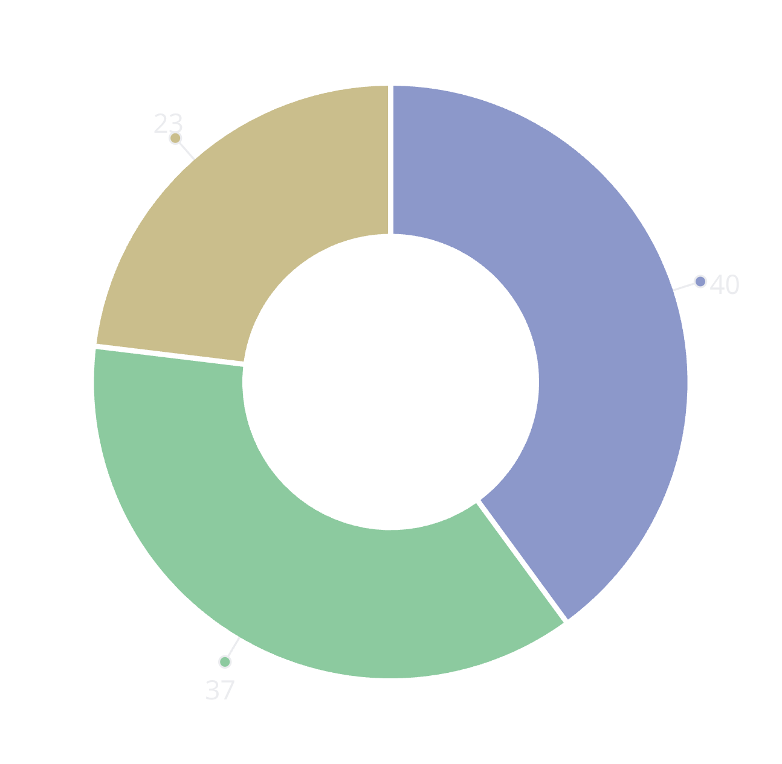
Payment Preferences: Digital Transformation Opportunity
Payment method distribution reveals significant digital transformation opportunities. While COD remains dominant at 40%, the combined digital payments (online + cards) represent 60% of transactions, indicating growing customer comfort with electronic payments.
Strategic Implications:
COD Dependency: 40% COD usage suggests trust-building opportunities through enhanced customer service and security messaging
Digital Growth: 37% online payment adoption shows strong digital engagement
Card Usage: 23% traditional card payments indicate established payment infrastructure
Optimization Strategy: Implement incentives for online payments to reduce COD processing costs while maintaining customer convenience and trust.
COD
Online
Cards

Slide 7



Regional Performance: West Region Dominance
41%
23%
West Region
East Region
Leading market with exceptional performance, generating nearly 2x other regions
Secondary market with solid performance and growth potential
18%
18%
South Region
Central Region
Balanced market coverage with expansion opportunities
Matched South region performance with growth potential
The West region's 41% market share dominance represents a significant competitive advantage and provides a proven success model for replication. The region generates nearly double the sales of other regions, suggesting superior market penetration, customer satisfaction, or operational efficiency.
Expansion Strategy: Analyze West region's success factors including customer demographics, product mix preferences, marketing channels, and operational practices. Apply these learnings to accelerate growth in the balanced but underperforming Central and South regions (18% each).

Slide 8
Shipping Preferences: Cost-Conscious Customer Base
73%
Shipping mode analysis reveals a cost-optimization mindset among our customer base. With 73% preferring standard shipping options, customers prioritize value over speed, suggesting price sensitivity that should inform our logistics and pricing strategies.
Standard Shipping
Combined standard and second class preferences indicate cost-conscious customers
Key Insights:
20%
Standard Class (196 orders): Dominant preference indicating cost-conscious decision making
First Class
First Class (72 orders): Significant premium service adoption shows segmented needs
Premium service adoption shows willingness to pay for faster delivery
Same Day (25 orders): Small but valuable urgent delivery niche
7%
This distribution suggests opportunities for shipping cost optimization and tiered service offerings that balance customer value expectations with operational efficiency.
Same Day
Niche urgent delivery market with premium pricing potential

Slide 9



Strategic Recommendations: Growth & Optimization Blueprint
Revenue Optimization
West Region Expansion: Replicate the 41% regional dominance model in underperforming markets. Analyze success factors including customer demographics, product preferences, and operational practices.
Corporate Segment Growth: Leverage 32% B2B share to develop enterprise solutions and bulk order programs that increase average order value and customer lifetime value.
Product Strategy
Office Supplies Focus: Build on 3.6K unit leadership with premium line extensions and subscription services for consumable products with repeat purchase patterns.
Technology Premium: Enhance the 1.1K technology category through targeted promotions and bundle offerings to maximize high-margin opportunities.
Operational Efficiency
Payment Digitization: Reduce 40% COD dependency through online payment incentives, improving cash flow and reducing processing costs.
Seasonal Planning: Capitalize on Q4 surge patterns with enhanced inventory management and logistics scaling to maximize December's 3x growth potential.

Slide 10
Key Success Metrics: Monitoring & Execution Framework
Primary Success Metric: Replicate West region's 41% performance model in Central and South regions while maintaining our healthy 10.9% profit margin across all product categories.
Growth Momentum Indicators:
Build on 2020's consistent YoY growth trajectory
Expand home office segment beyond current 19% share
Increase corporate segment penetration from 32%
Monthly KPI Monitoring Priorities:
Optimize shipping cost structure while maintaining service quality
Regional Performance Tracking: Monitor West vs. other regions monthly to identify replication opportunities
Success will be measured by our ability to scale the West region model while preserving profitability and operational efficiency across our expanding market presence.
Profit Margin Maintenance: Ensure 10.9% margin consistency across all product categories during expansion
Payment Mix Evolution: Track digital payment adoption rates and COD reduction progress
Seasonal Revenue Patterns: Prepare for Q4 surge while planning for post-holiday Q1 performance

